Slide 1

Path of dark

Slide 2
About Game Logic
Objective: Explore rooms, collect rewards, and defeat enemies to progress through levels.
Start: Player enter a room, contains either an enemy or a reward.
Events:
Enter Reward Room
Enter Enemy Room
Combat Mechanics:
Attack (A)
Heal (H)
Progression:
Player continues exploring and battling until their health depletes.
End Condition: Game ends if player’s health reaches zero or they decide to quit after any level.

Slide 3
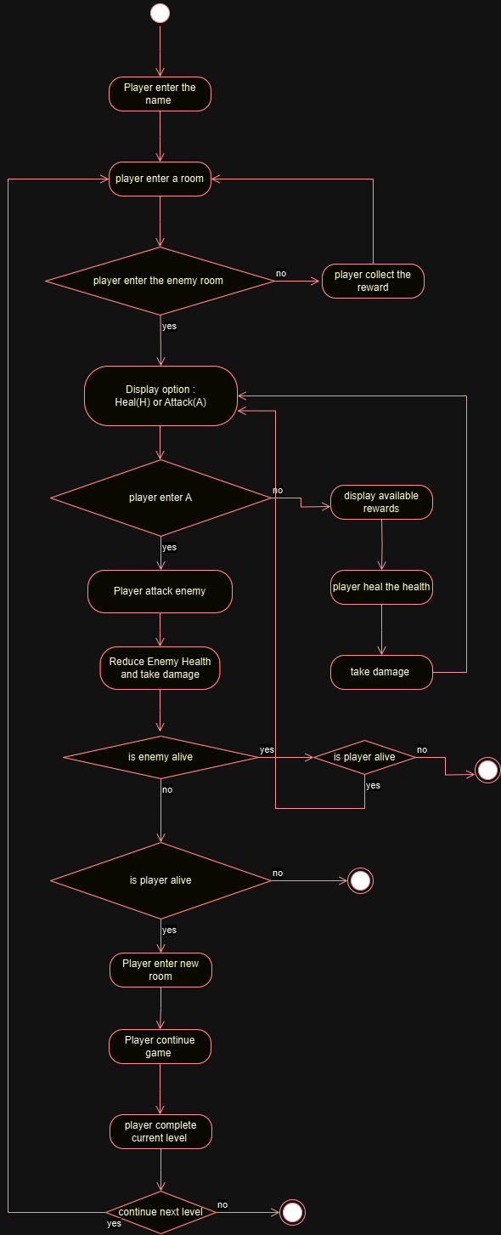
Activity Diagram

Slide 4
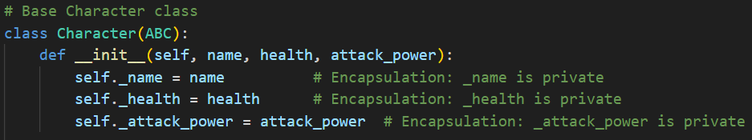
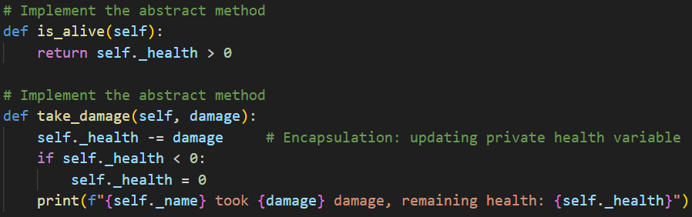
Applied Encapsulation
Health, attack power, and name are defined as private variable
Manipulated via methods take_damage() and is_alive()

Slide 5
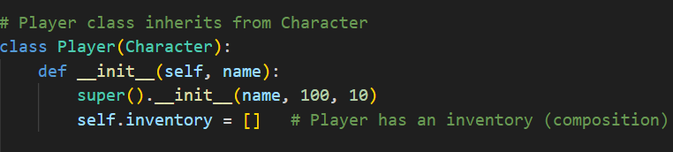
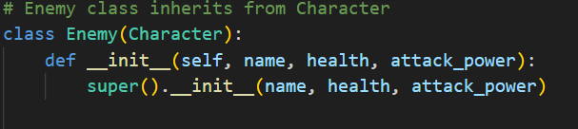
Applied Inheritance
Defined class for Character.
Player and Enemy classes inherit from Character.

Slide 6
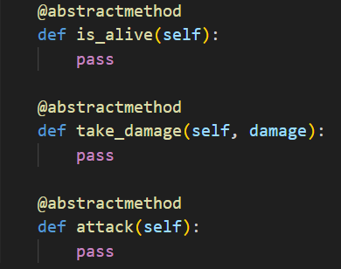
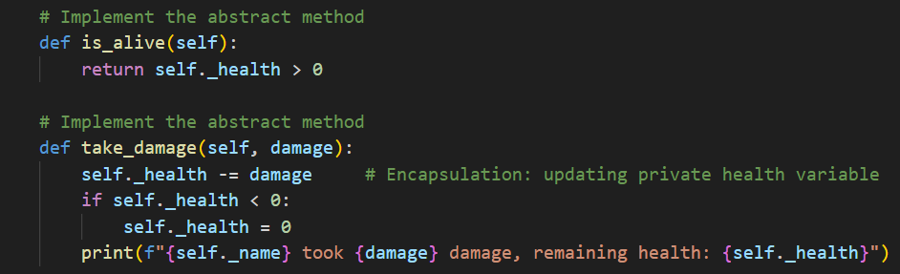
Applied Abstraction
Defined abstract methods
is_alive()
take_damage()
attack()

Slide 7


Applied Polymorphism
Both Player and Enemy inherit the attack() method
Behave differently.
Player : implemented with fixed damage
Enemy : implemented with random damage

Slide 8
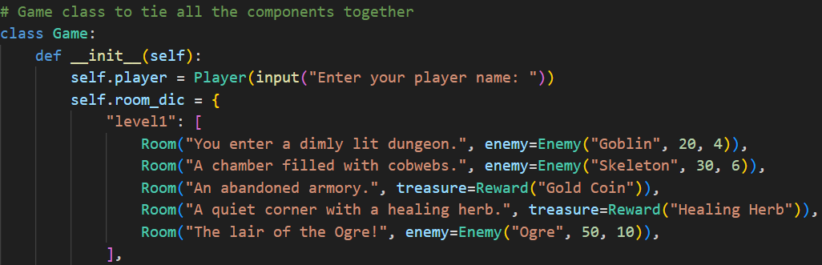
Applied Composition
Game object compose Player , Enemy and Room objects.

Slide 9
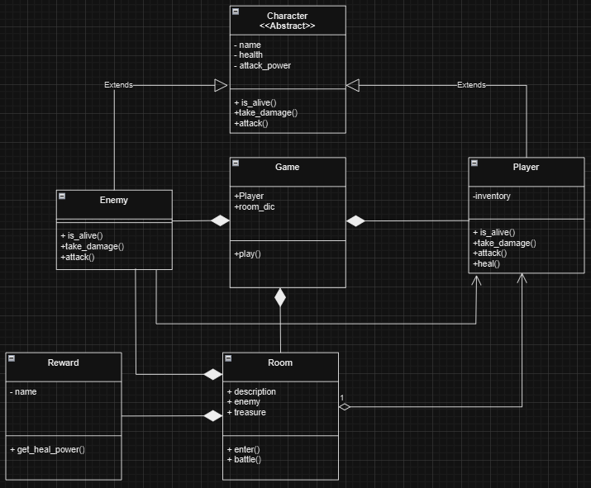
Class diagram

Slide 10
LIVE DEMO
https://www.youtube.com/watch?v=pq8gxd6u4GA

Slide 11
Future improvement
Set levels and rooms combination (easy, medium, advanced)

Slide 12
Thank you
240248516
c.shobanapriyan

